Slide 1

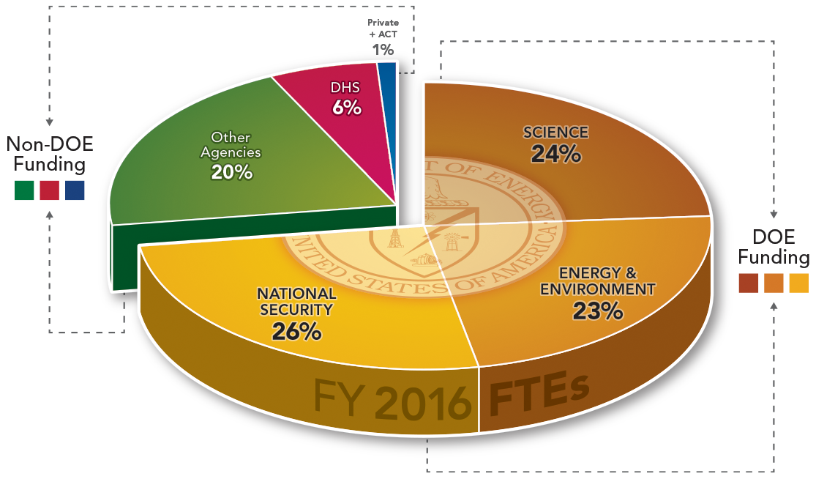

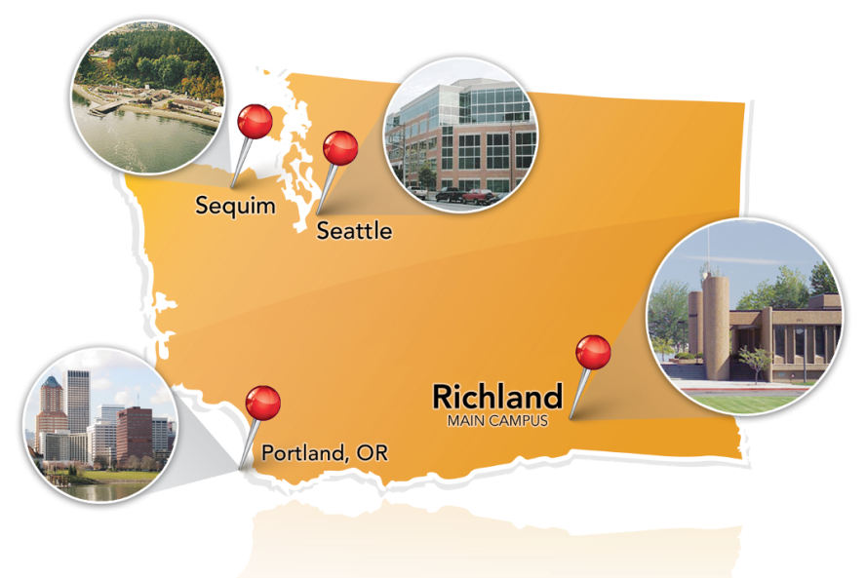




PNNL at a Glance
~$900M in annual R&D expenditures
4,400+ scientists, engineers and non-technical staff
>2500 U.S. & foreign patents granted
85 FLC Awards, 107 R&D 100 Awards
>1000 peer-reviewed publications per year
Mission-driven collaborations with government, academia and industry
Among DOE’s top-performing labs; a premier chemistry, environmental sciences and data analytics laboratory
www.pnnl.gov

Slide 2
EIBD Core Capabilities
Buildings
Grid
Power System Operation, Planning and Security
Advanced Grid Analytics
Electric Power Modeling and Simulation
Cyber Security of Energy Delivery Systems
Energy Storage
Grid Modernization/SmartGrid/Distribution
Building Energy Codes and Appliance Standards
Building Energy Performance & Simulation
Energy Economics
Energy Efficient Lighting
Technology Policy & Market Adoption
Advanced Controls
Building-Grid Integration
Transactive Energy

Slide 3
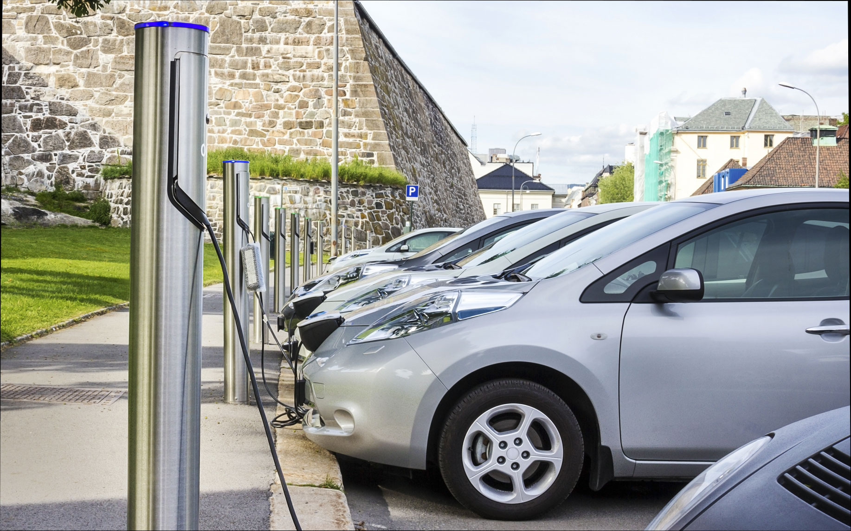






Control of Complex Systems Initiative (CCSI)
Theory to underpin system-wide control of large infrastructures
Tools to support implementation and deployment of resulting methodologies
Test bed to validate the approach
Theory:
Divide and conquer approach to ultra-large systems
Algorithms that are scalable, deployable, robust, resilient, and adoptable
Tools
Co-simulation
Visualization
Validation and verification
Test Bed
Large-scale simulation
Hardware-in-the-loop
http://controls.pnnl.gov/.
Notes:
The Control of Complex Systems Initiative employs a unique integrated systems approach with three focus areas: Theory, Tools, and Test Bed.
The focus area on theory provides a theoretical underpinning of system-wide control of large infrastructures. It takes a divide and conquer approach to large scale systems. The focus is on algorithms that are scalable, deployable, robust, resilient, and adoptable.
State-of-the-art control theory is able to handle medium-to-large systems such as a power plant, but not ultra-large scale systems such as the entire power grid. Therefore, we need scalable control solutions in order to handle our large infrastructures.
New controls for a large infrastructure have to be implemented in an incremental and modular fashion. Therefore, we need deployable control solutions.
Models of large infrastructure systems will inherently be inaccurate due to the complexity, and the infrastructure itself will be in continuous change. Therefore, we need robust control solutions.
Large infrastructure systems are subject to malfunctions and possibly attacks. Therefore, we need resilient control solutions.
New control systems need to be aligned with stakeholder boundaries and business models for those who implement them, and they need to be valuable for end users. Therefore, we need adoptable control solutions.
We believe that a new approach to controls is an essential component in solving the problems associated with our country’s outdated and aging energy infrastructure. CCSI is unique in that it brings a systems approach to addressing the issues of scalability; deployability; robustness; resilience; adoptability.
Our systems approach will accomplish these objectives by a research plan divided in three focus areas: theory, tools and test beds.
New control theory to handle the increasing complexity and variability,
Software tools to validate and deploy the new control approaches, and
We are constructing a test bed to validate both control methodologies and SW tools.
[Non-technical audience. Explain architecture, algorithms and systems perspective.
Architecture
Algorithms
Systems perspective]

Slide 4
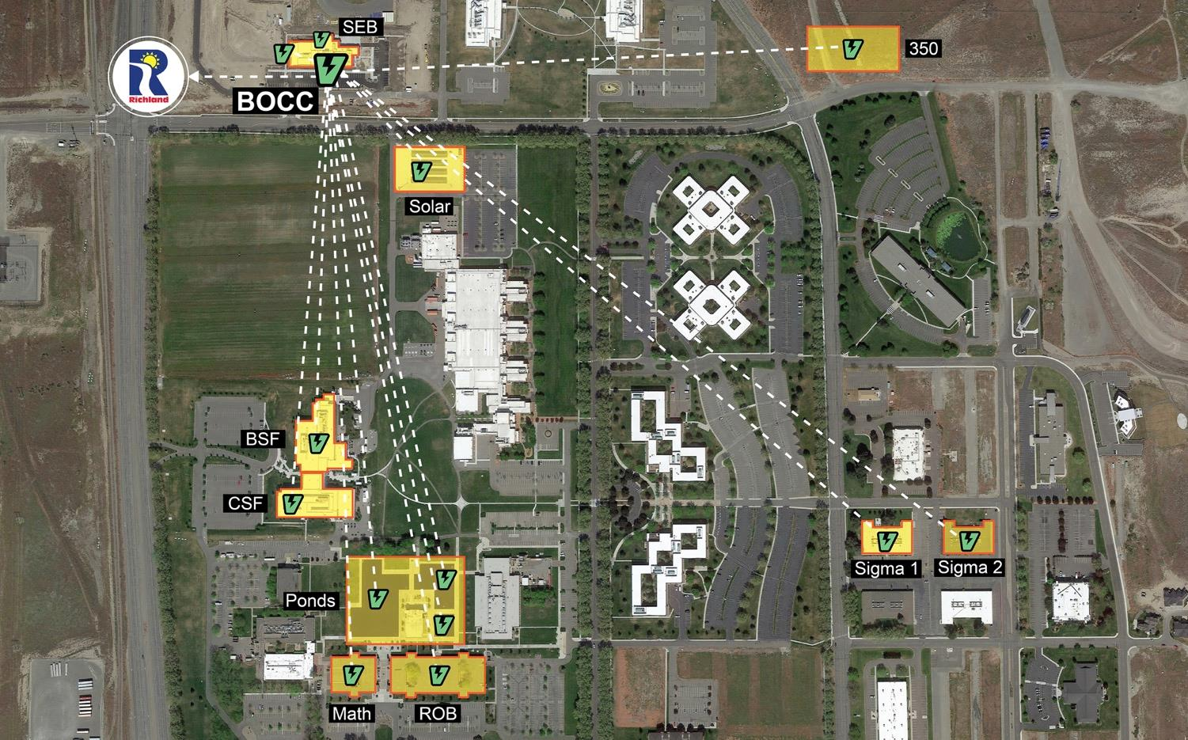
PNNL Campus: A Transactive Laboratory
Real-time decision engine combining data, analytics and control for transactive systems
Transactive node capabilities
Real-time quantification of resource flexibility
Real time decision making and control of resource consumption
PNNL campus: a Transactive Laboratory

Slide 5
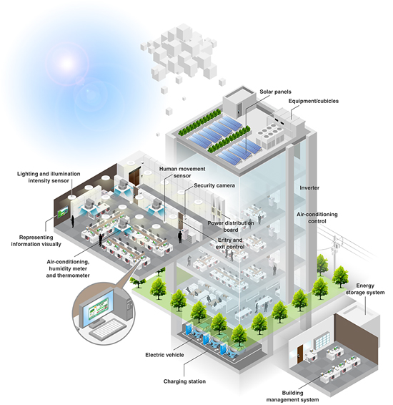
Modern buildings: connected energy hubs
Human Centric, Reliable, Sustainable, Secure
Uncertainty, Diversity,
Actuation, Sensing,
Bi-directional flow of power
Multiple stakeholders
Cyber-Physical system
Energy hub
“Alpha Go isn’t just an expert system built with handcrafted rules, […] but instead it uses general machine learning techniques to figure out for itself how to win at Go” - D. Hassabis
Notes:
In case of buildings the system diversity is a differentiating challenge: each building energy system is uniquely designed.
Existing buildings are operated based on handcrafted rules designed to optimize efficiency.
To enable a transactive energy future, we aim to provide buildings with learning and context aware decision capabilities.

Slide 6

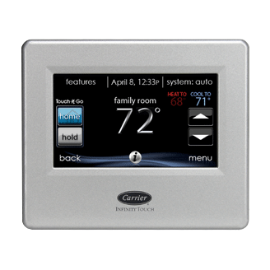


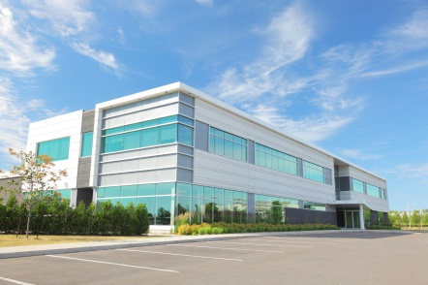


Motivation
Diversity of building characteristics
Residential
Small/med commercial
Large commercial
Stakeholder: home owner
Split control system using single thermostat
Energy efficient equipment
Local electricity generation
Some demand response capability is enabled
Fire detection systems
Security systems
No integration across home systems
Stakeholder: real estate owner / small business owner (renter)
Remote terminal unit and roof top unit (RTU) control system using single thermostat
Split-incentive issues
Rarely include energy efficiency measures
Fire detection and suppression systems
Security systems
Stakeholder: real estate owner / building energy manager
Centralized distributed control system using building automation
Centralized BMS/BAS
Advanced energy efficiency measures installed
Energy monitoring dashboards
Demand response capability
Fire detection and suppression systems, security systems

Slide 7
Building Controls for Energy Efficiency: Adaptive Control
PNNL, ORNL
Draguna Vrabie, PhD
Draguna.Vrabie@pnnl.gov

Slide 8
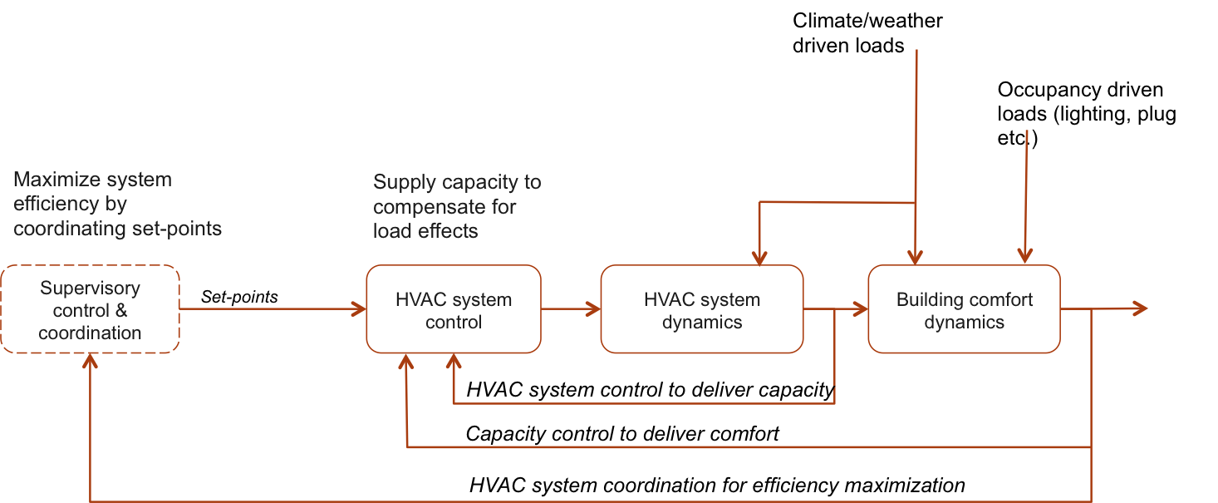
Building Controls for Energy Efficiency: Adaptive Control
Building HVAC controls challenge: coordinate operation in presence of uncertainty
Objectives
Eliminate need for manual seasonal tuning of supervisory control: self-learning
Fault tolerant operation: self-configuring
Scalable installation process: cost-effective

Slide 9
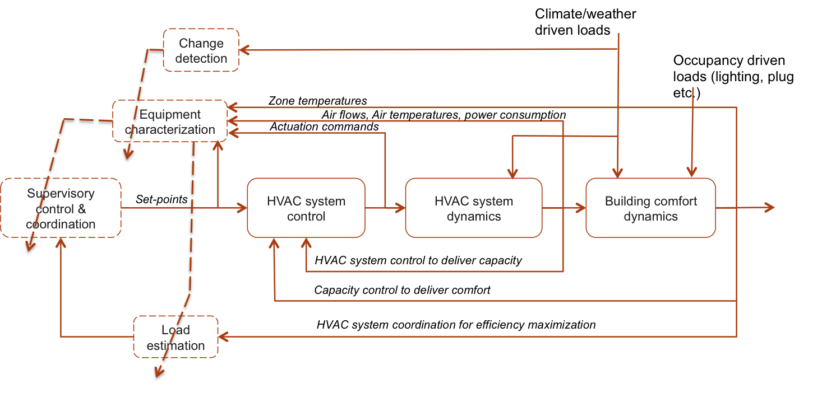
Building Controls for Energy Efficiency: Adaptive Control
Coordinated equipment operation in presence of uncertainty
Approach
Automated methods for performance monitoring and data-driven system characterization with uncertainty bounds
Robust optimization for set-point coordination: self-optimizing

